Slide 1
Introduction to Unity
CaramelYo

Slide 2
Outline
Before Class
Introduction
Component Behavior
Component-oriented Design
Using Package
Notice
Homework
Next Class

Slide 3
Outline
Before Class

Slide 4
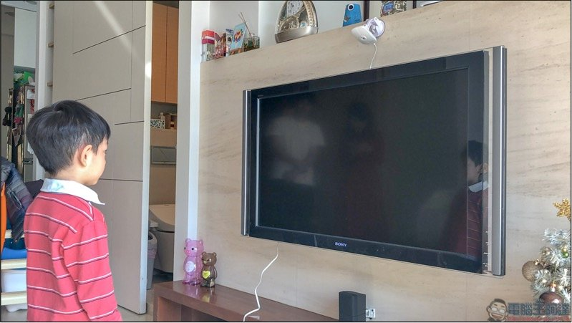
Before Class
Recommendation
Use your own laptop (notebook) in this course (with unity 2020.3.21f1)
Sit closer to lectern as possible as you can

Slide 5
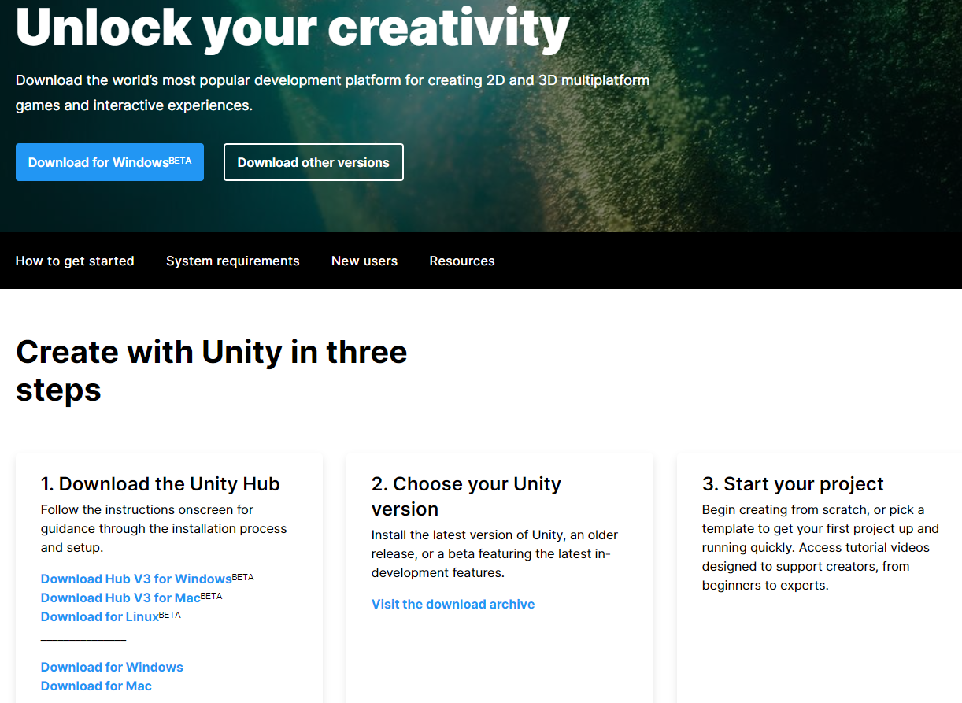
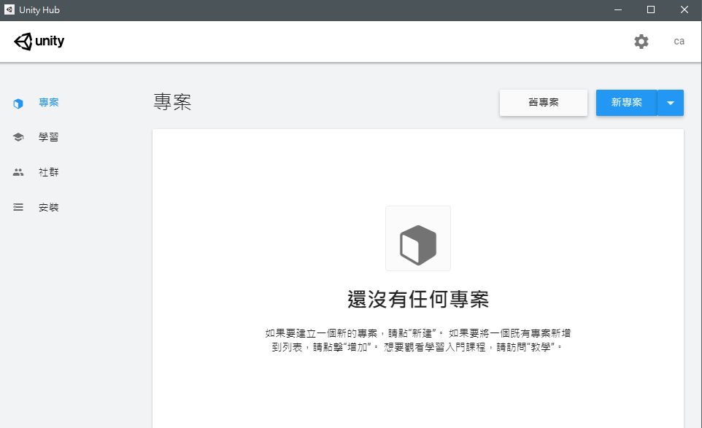
Before Class
Download Unity
Download the Unity Hub and install it：https://unity.com/download#how-get-started

Slide 6
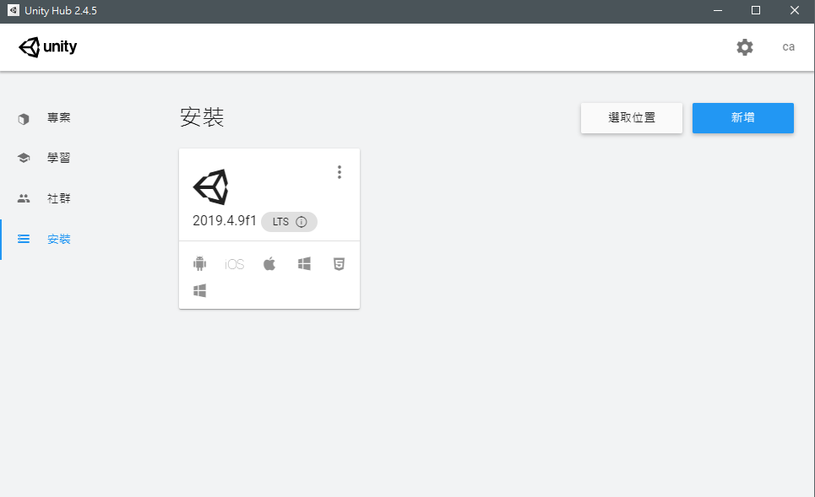
Before Class
Download Unity
Click “install” and “new”

Slide 7
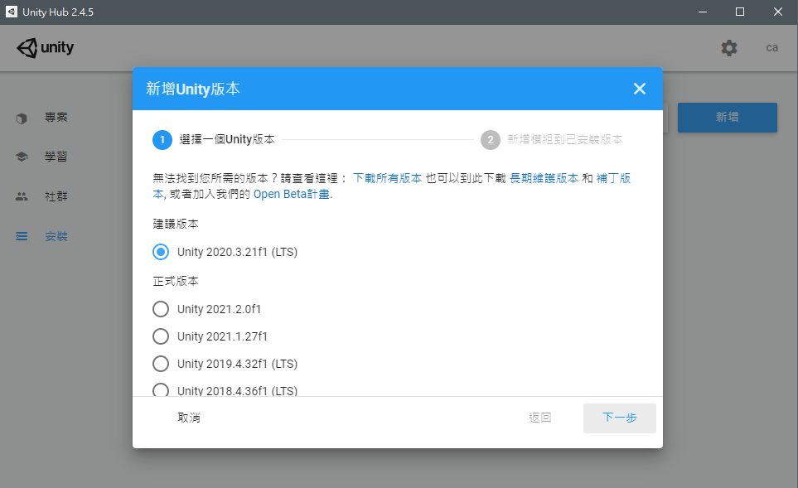
Before Class
Download Unity
Choose the “Unity 2020.3.21f1 (LTS)” (long term support)

Slide 8
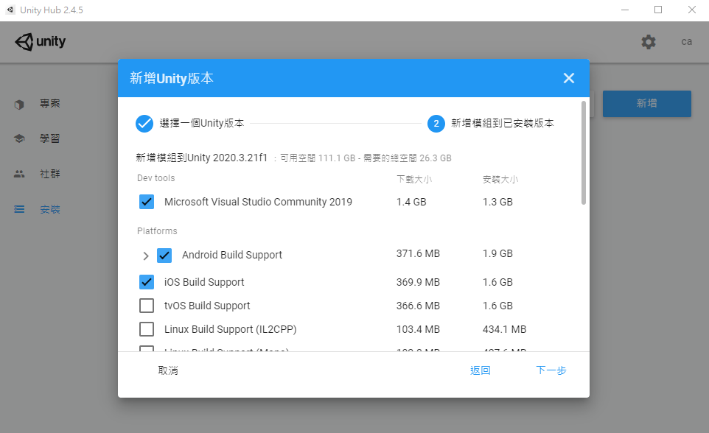
Before Class
Download Unity
Recommend Visual Studio 2019 (VS 2019) by default
We use Visual Studio 2017 as editor, so you don’t need to download VS 2019
No need！
X
Choose those platforms you need

Slide 9
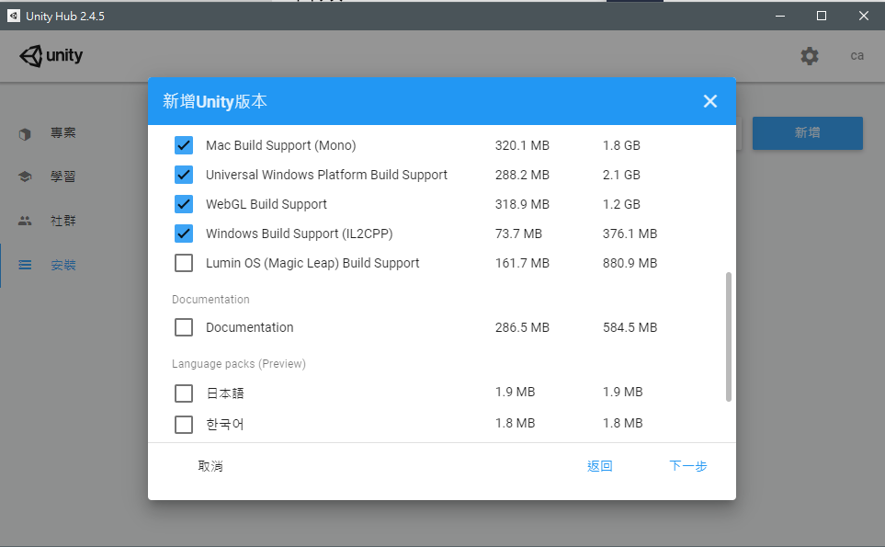
Before Class
Download Unity
Choose those platforms you need

Slide 10
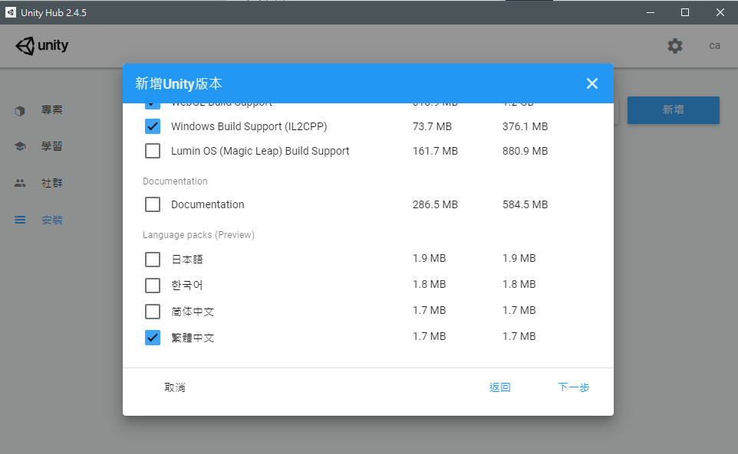
Before Class
Download Unity
Choose the languages you need
Choose the languages you need

Slide 11
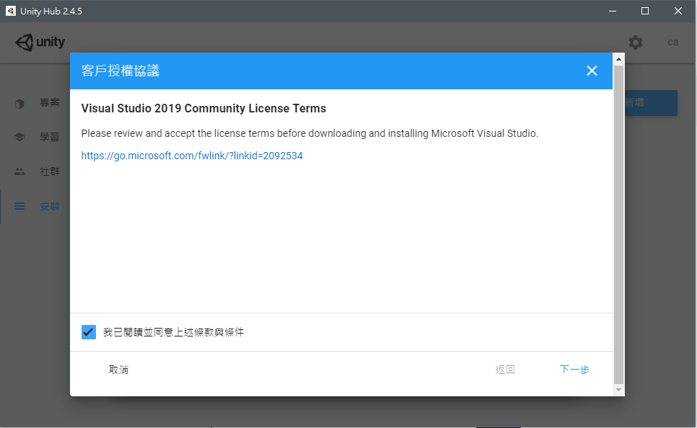
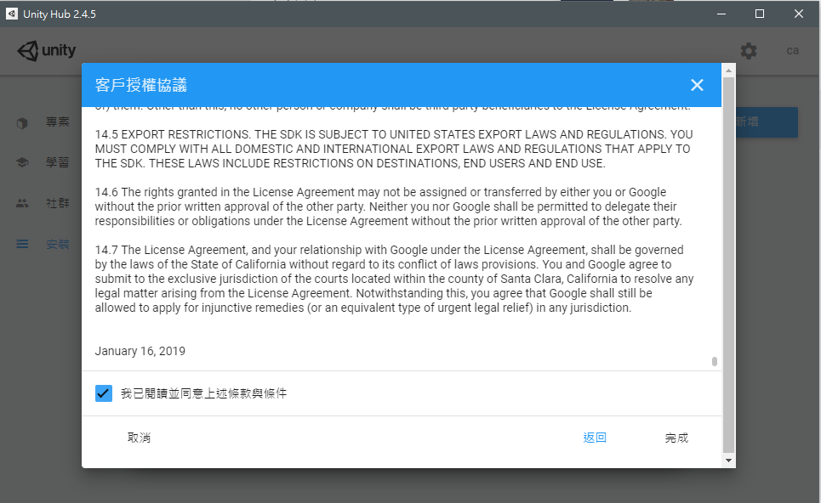
Before Class
Download Unity
Agree all and then install…

Slide 12
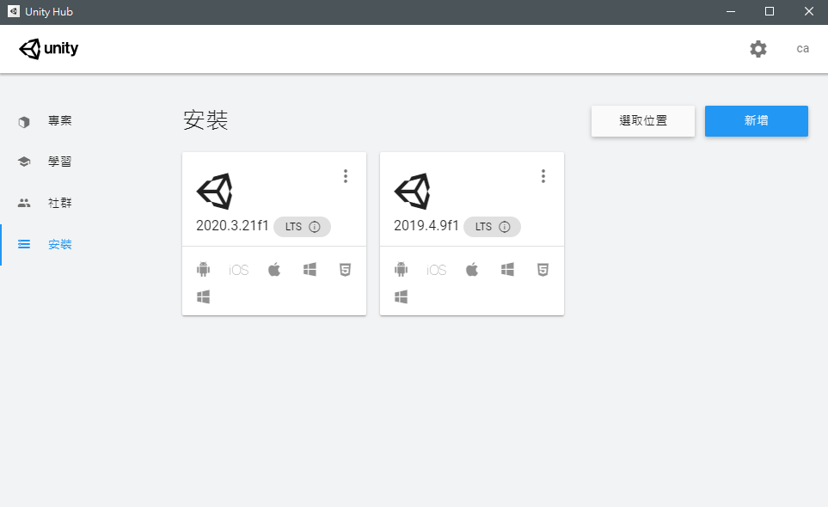
Before Class
Download Unity
After installation…

Slide 13
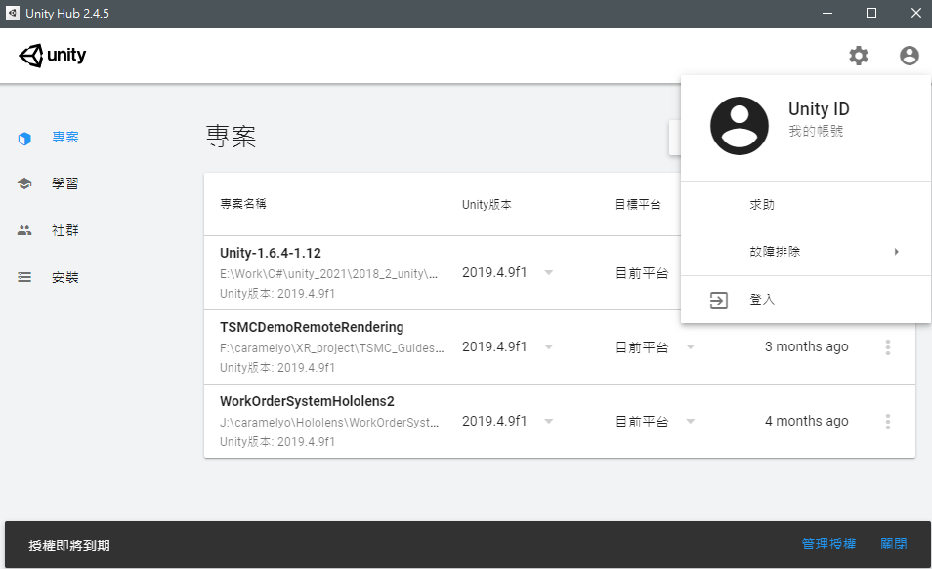
Before Class
Sign in your unity account

Slide 14
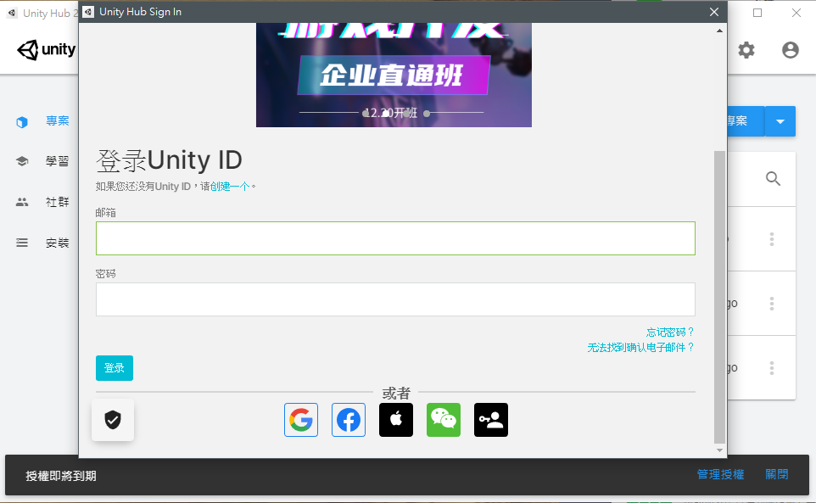
Before Class
Sign in your unity account
If you don’t have it, please sign up first

Slide 15
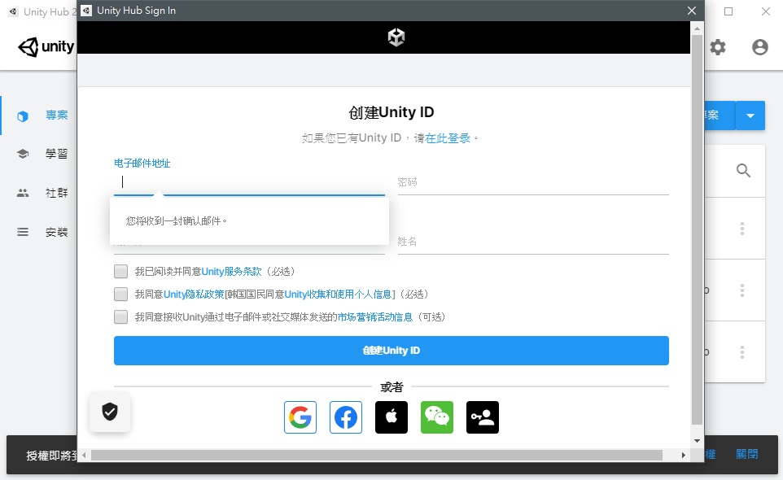
Before Class
Sign in your unity account
If you don’t have it, please sign up first

Slide 16
Before Class
Sign in your unity account
After you sign in…

Slide 17
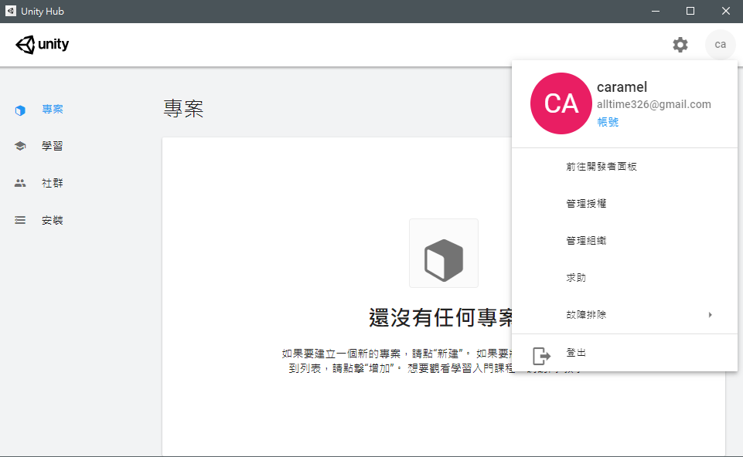
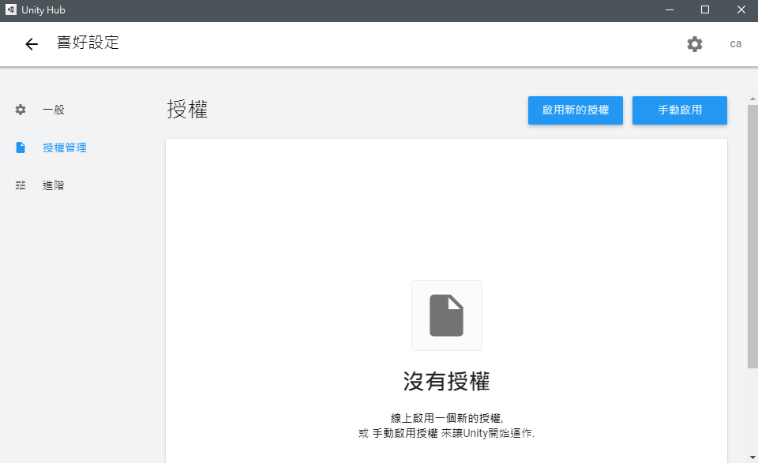
Before Class
Activate your license
If you don’t activate your license…

Slide 18
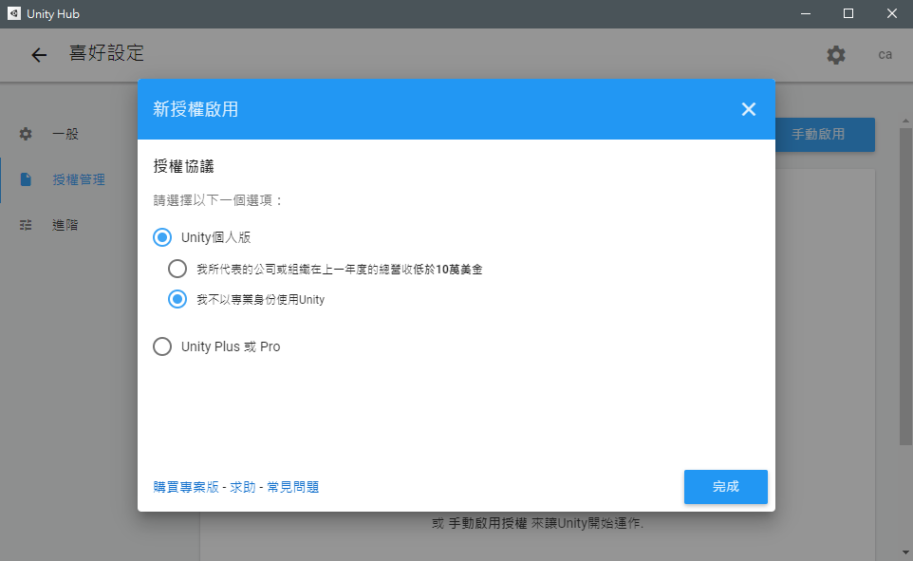
Before Class
Activate your license
Activate…

Slide 19
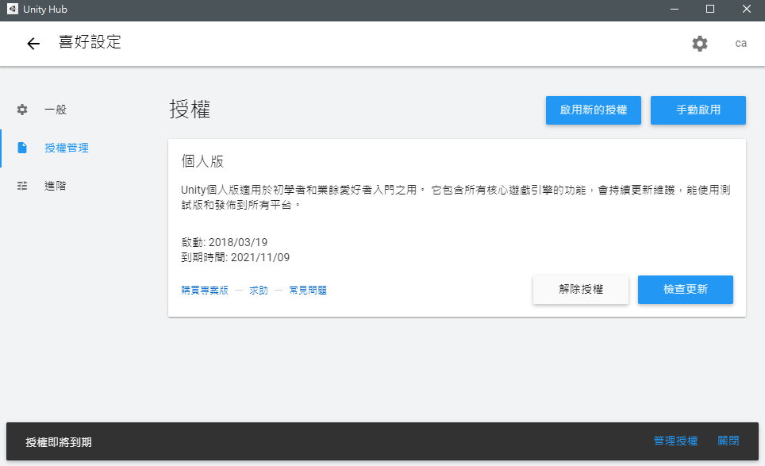
Before Class
Activate your license
3 days only

Slide 20
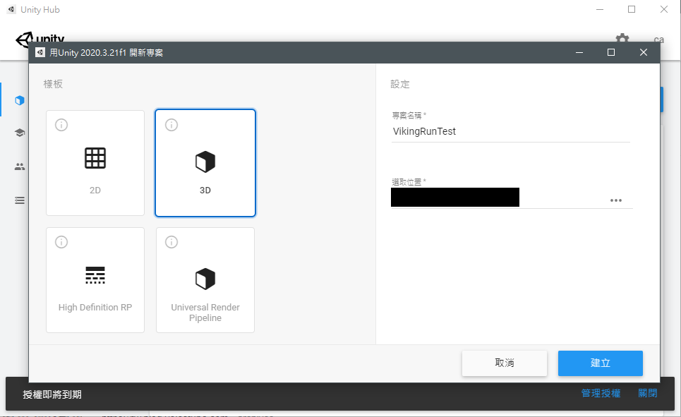
Before Class
New project
Create a new project and wait…

Slide 21
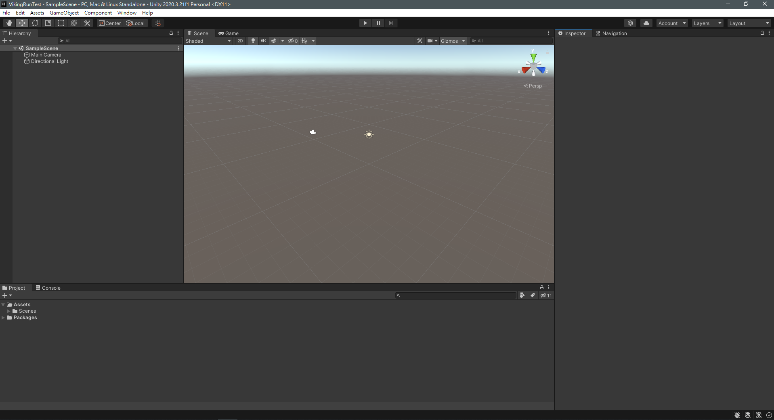
Before Class
New project
Work！

Slide 22
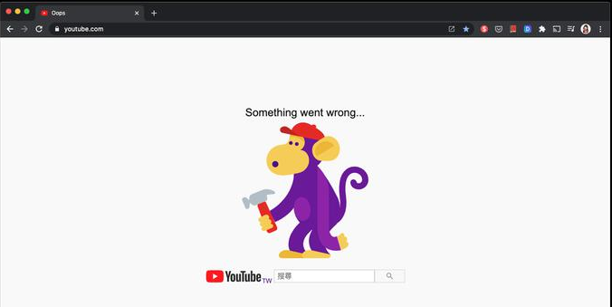
Before Class
What can you do if you cannot log in unity?
Ensure whether the account and password you input is correct
Unity server is under maintenance, so all you can do is to wait

Slide 23
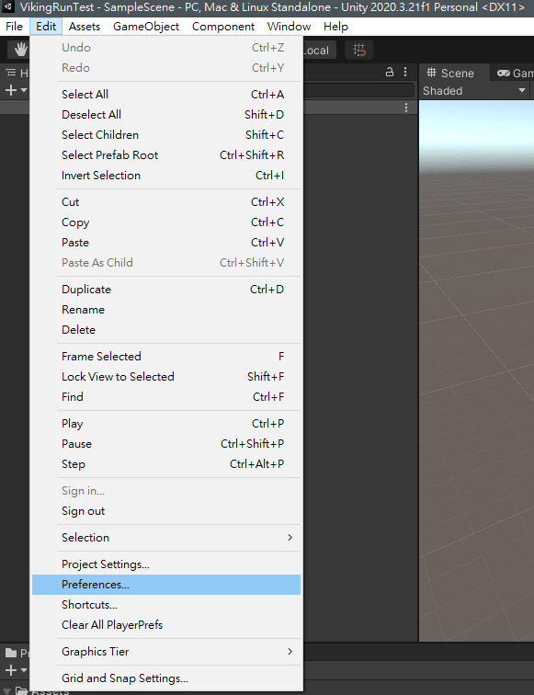
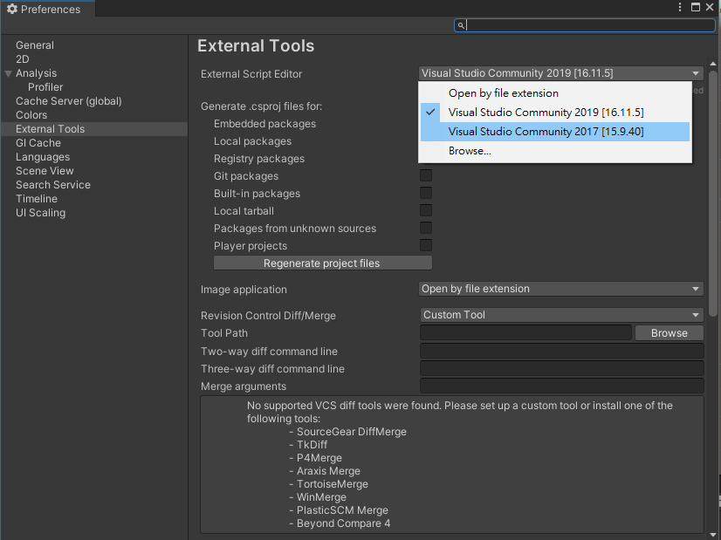
Before Class
Change the script editor into VS 2017
Edit(Top-left) => Preferences => External Tools => External Script Editor => Visual Studio 2017

Slide 24
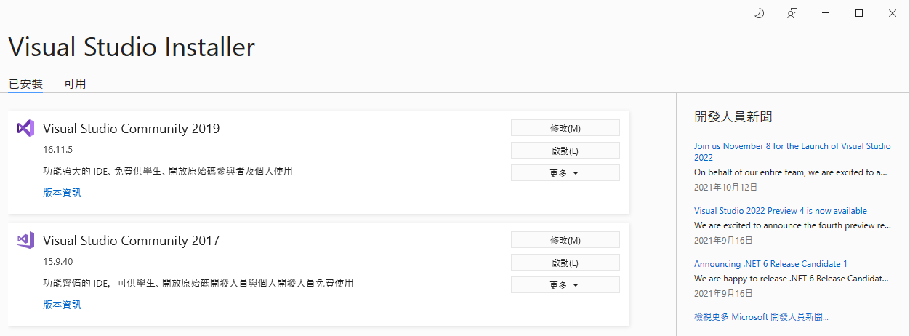
Before Class
Install Unity dependency on VS 2017
Download the VS installer on MS-VS and run it
Modify VS 2017

Slide 25
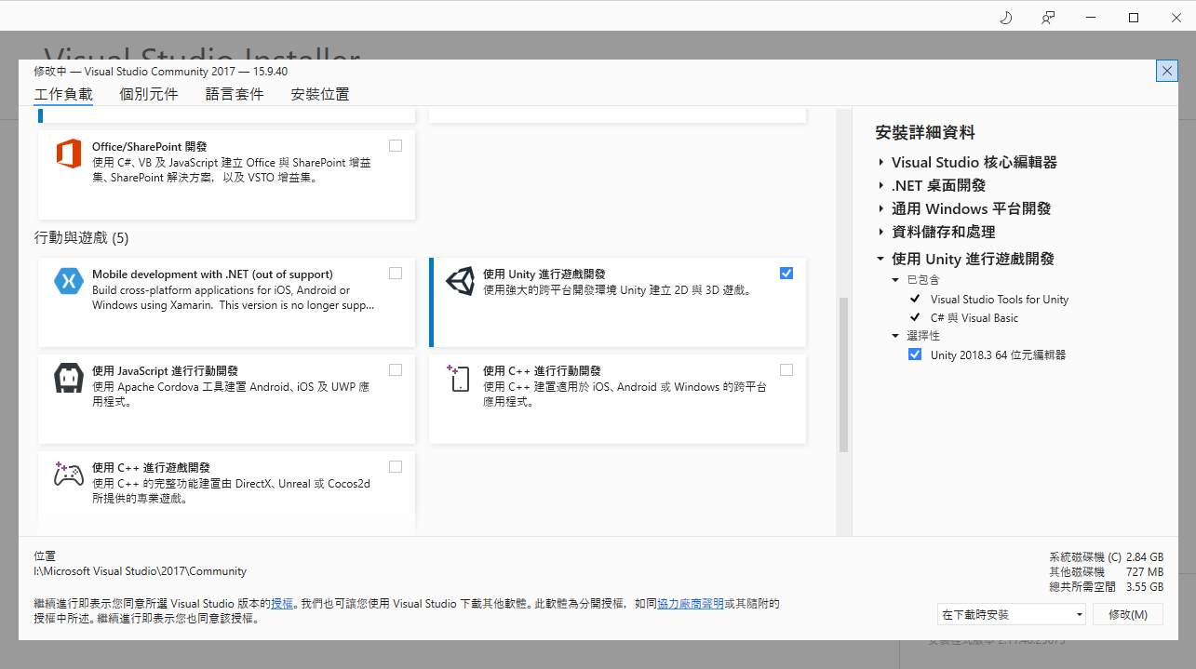
Before Class
Install Unity dependency on VS 2017
Install the Visual Studio Tools for Unity

Slide 26
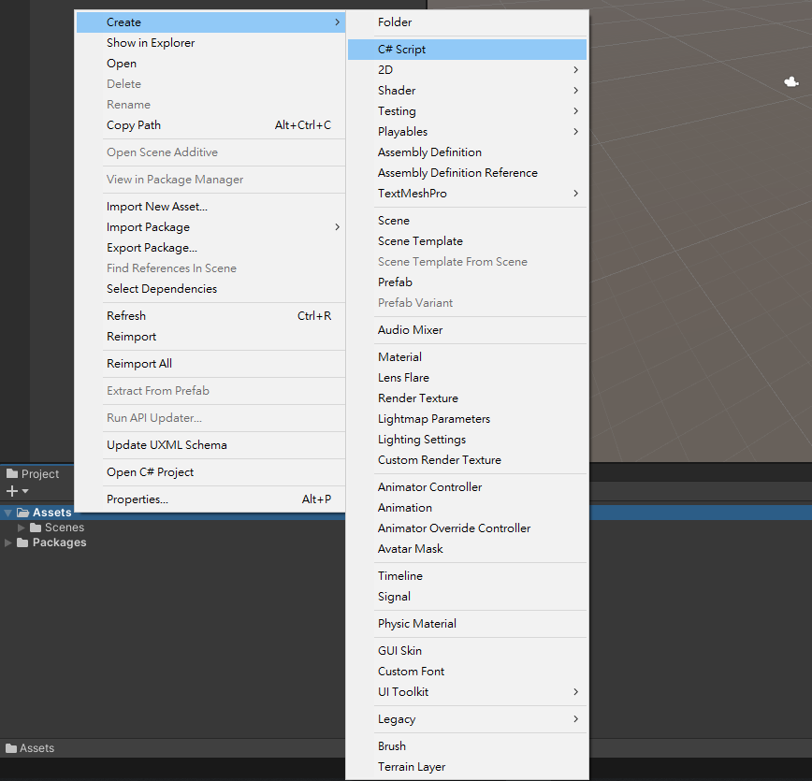
Before Class
New Script
Test script editor
3. Name “Test”
1. In “Project” window
2. Right click

Slide 27
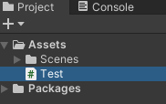
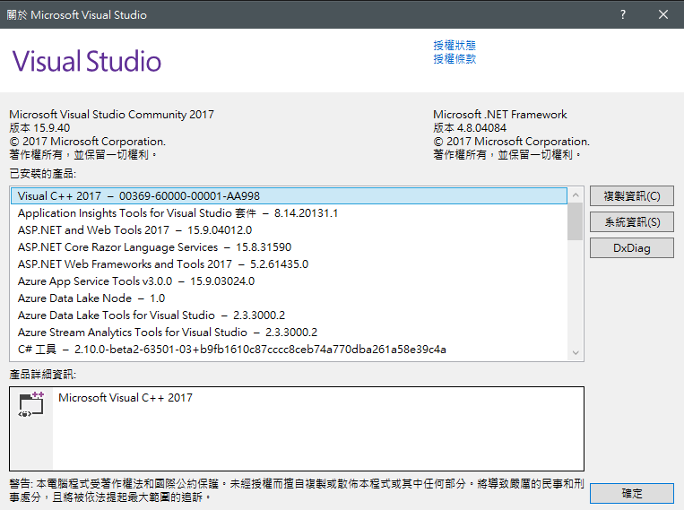
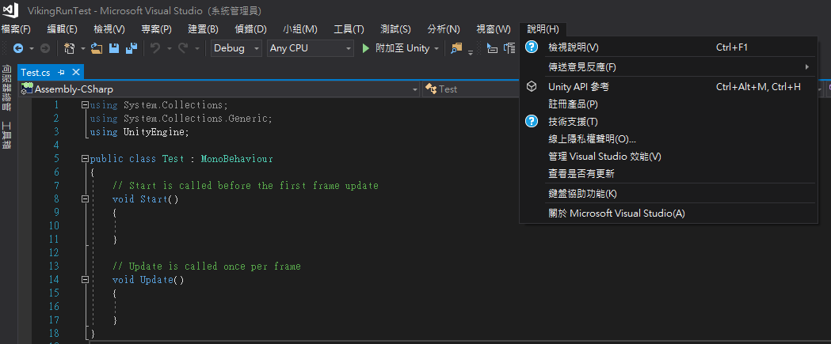
Before Class
New Script
Open the “Test” script
Double click

Slide 28
Outline
Introduction

Slide 29

Introduction
Personal profile
Nick name：CaramelYo (Yo)
Domain：Computer Graphics (CG)
Skills：C#、C++
Age：18
Objective：enter CSIE in NCKU

Slide 30
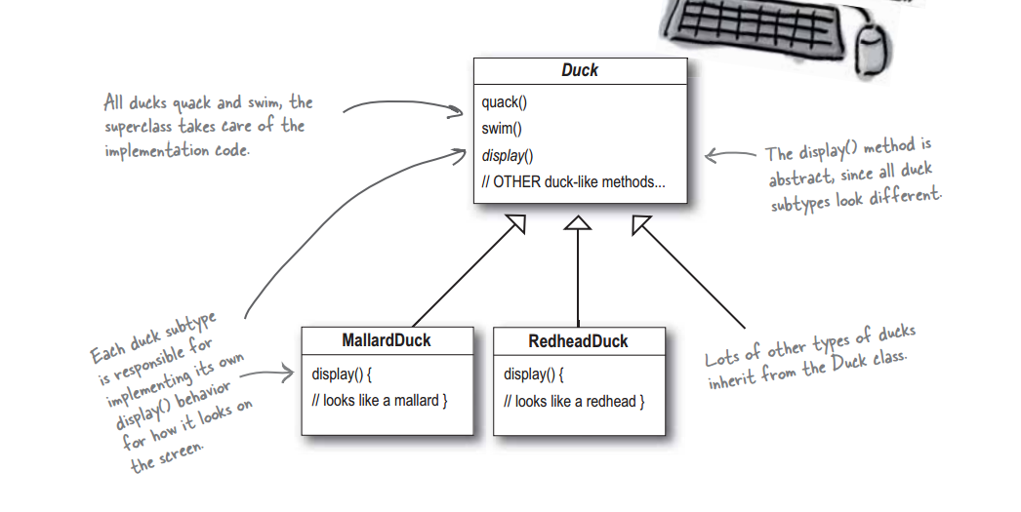
Introduction
Object-oriented (example in Head First Design Patterns)

Slide 31
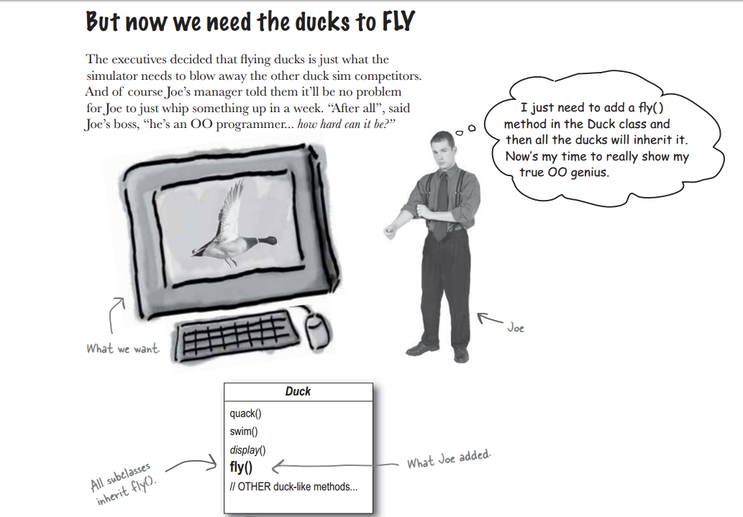
Introduction

Slide 32
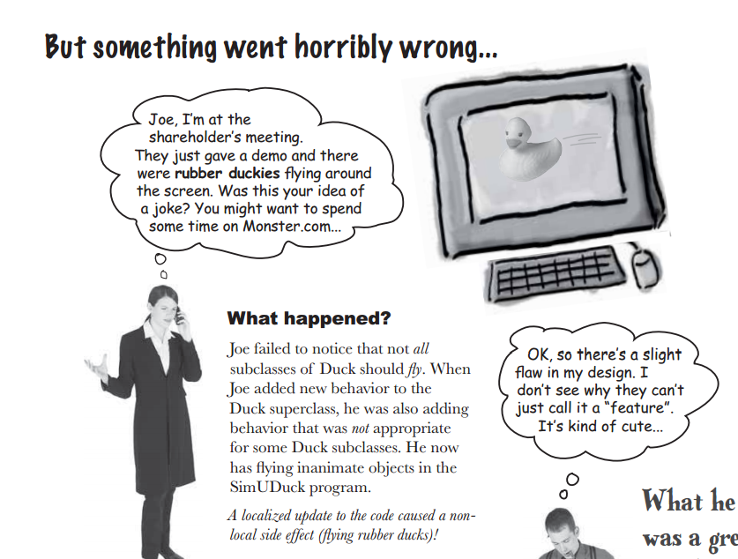
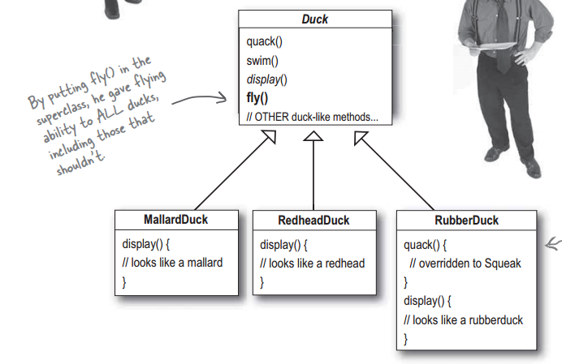
Introduction

Slide 33
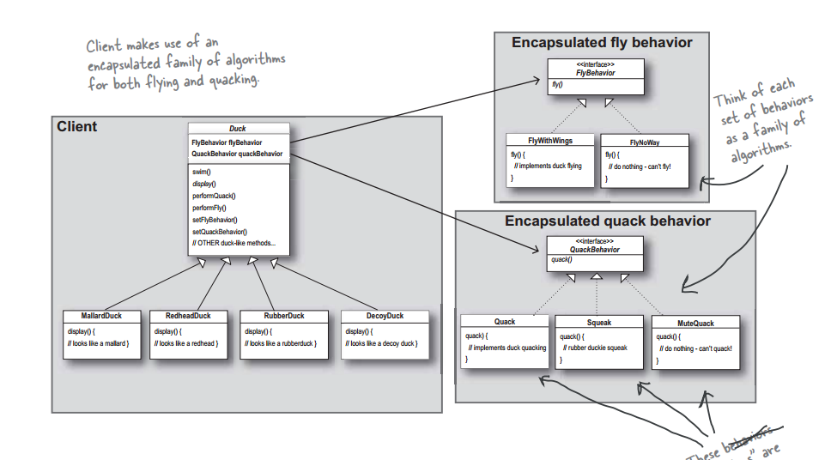
Introduction

Slide 34

Introduction
Component-oriented
Mallard Duck
Transform Renderer Wings
Redhead Duck
Transform Renderer Wings
Rubber Duck
Transform Renderer

Slide 35



Introduction
Unity V.S. Unreal engine
In my opinion
 | Unity | Unreal engine
Learning curve | Easy | Hard
UI / X | Good | Normal
Development cycle (for most case) | Fast | Slow
Cost | Low | High
Cross-platform | Many | Normal
Language | C# / JavaScript | C++
Notes:
廢課 ??

Slide 36
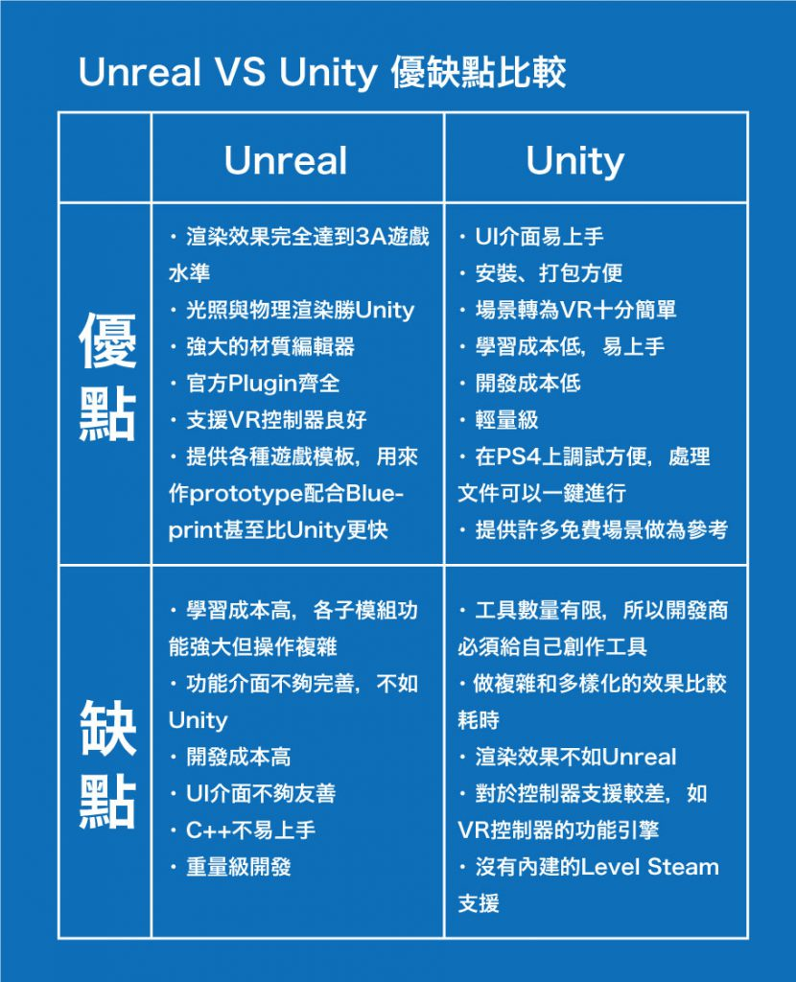
Introduction
Unity V.S. Unreal engine
For more details, please reference to this web and this video

Slide 37
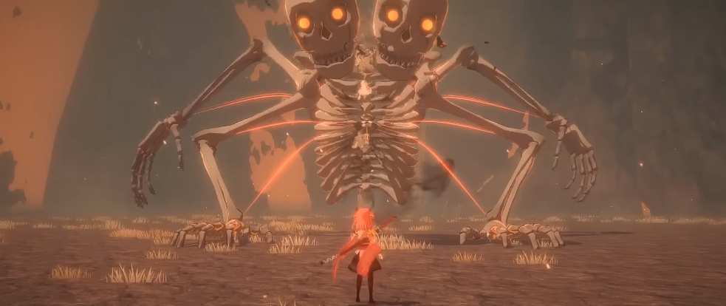
Introduction
Unity
炎姬
《炎姬》是由學生「小牛奶」一人以 Unity 3D 引擎製作的第三人稱動作角色扮演遊戲

Slide 38
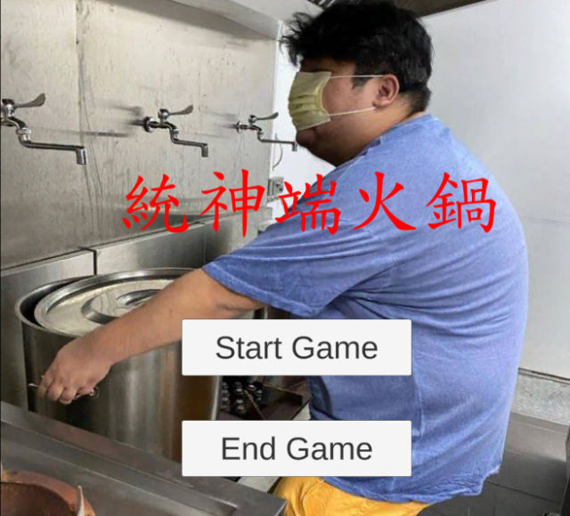
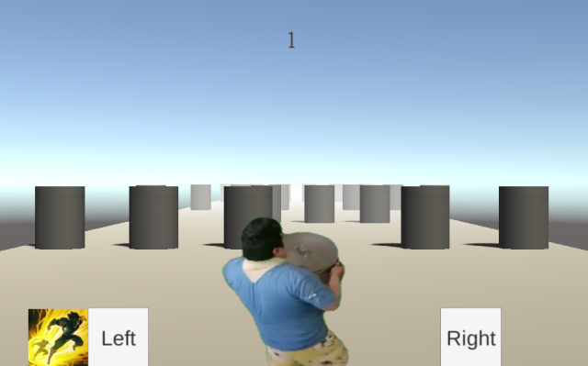
Introduction
Unity
統神端火鍋

Slide 39

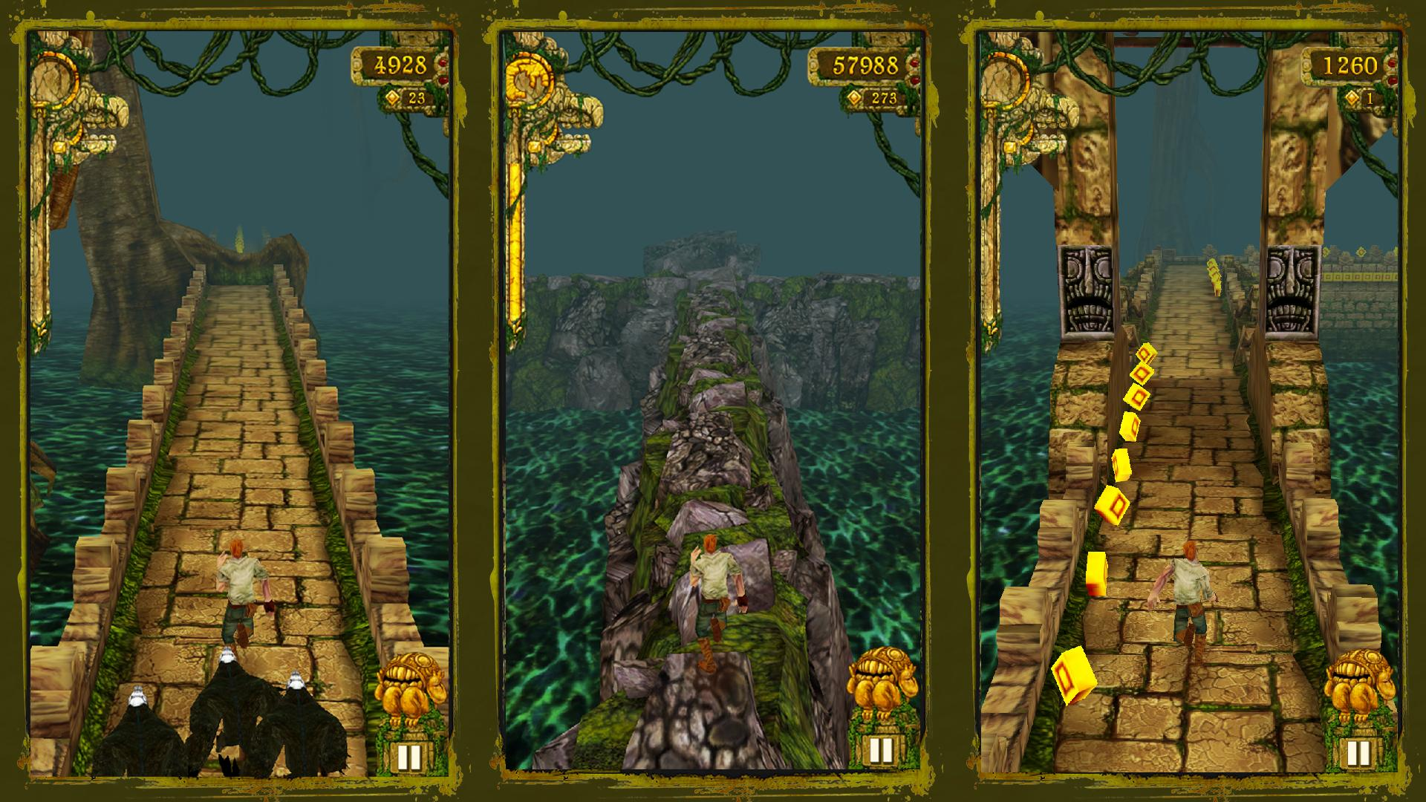
Before Class
What will we do ?
TempleRun！

Slide 40
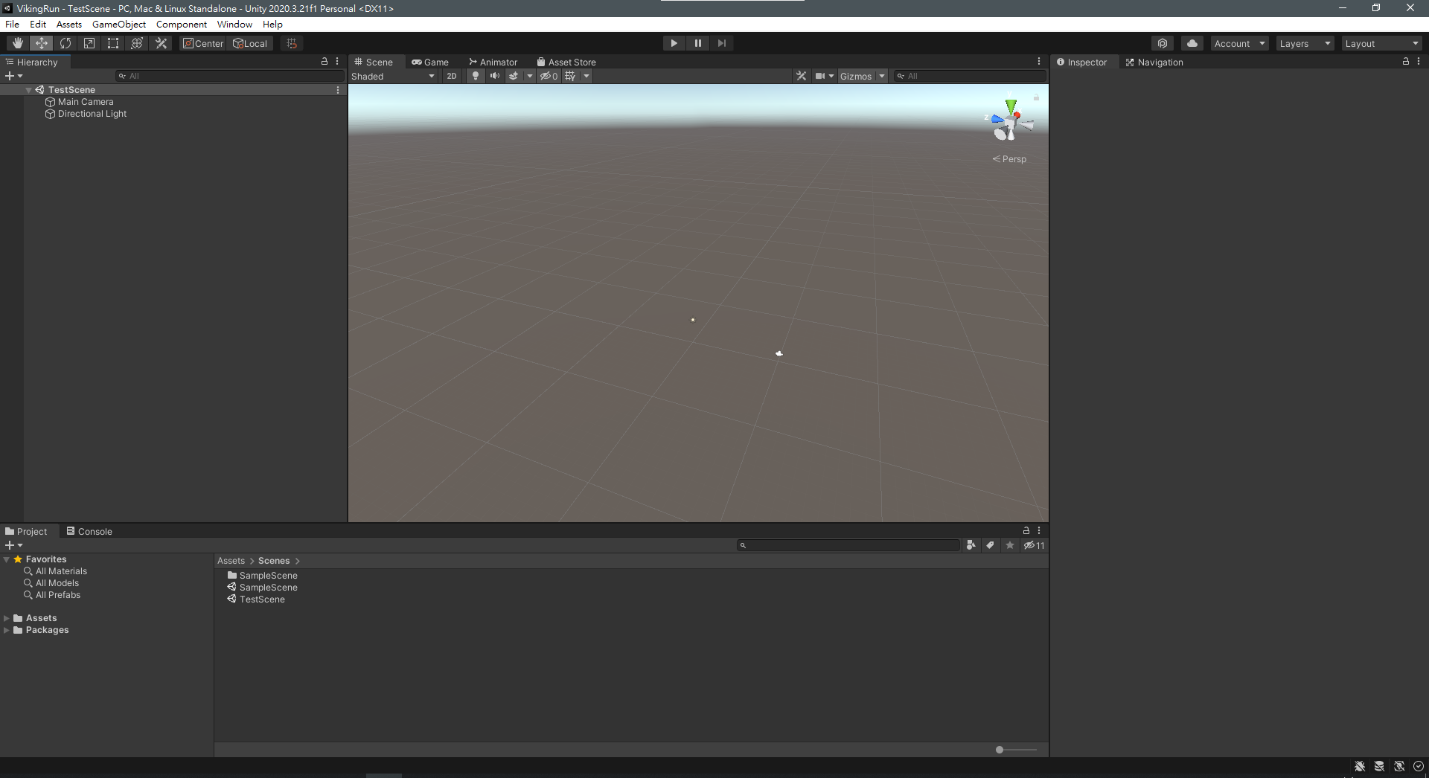
Introduction
Interface

Slide 41
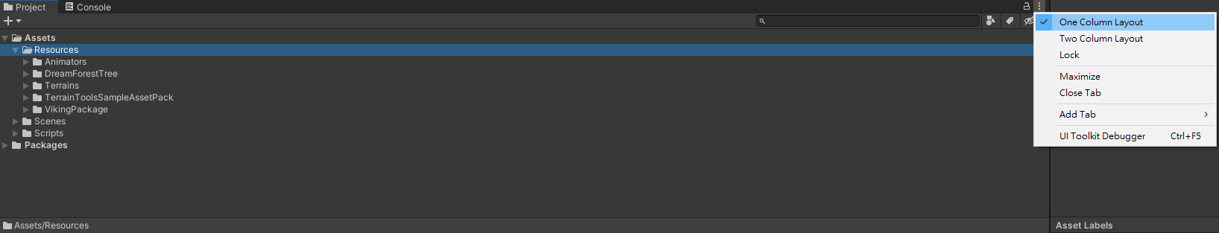
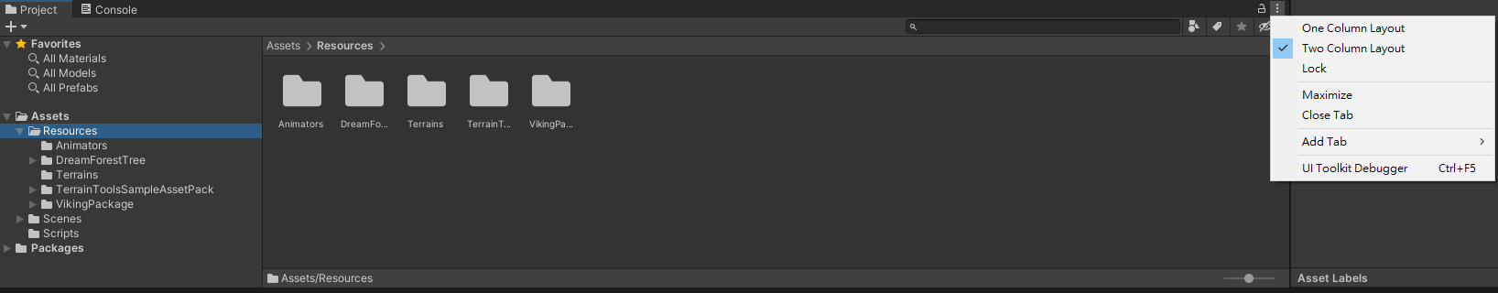
Introduction
Project

Slide 42
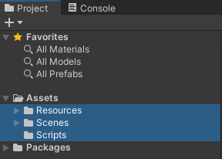
Introduction
Project

Slide 43
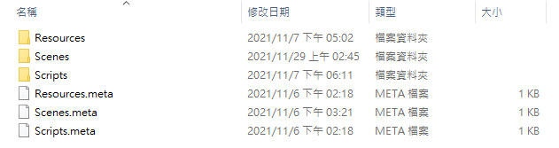
Introduction
Directory

Slide 44
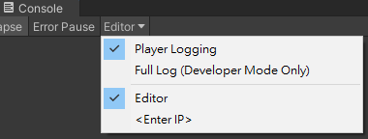
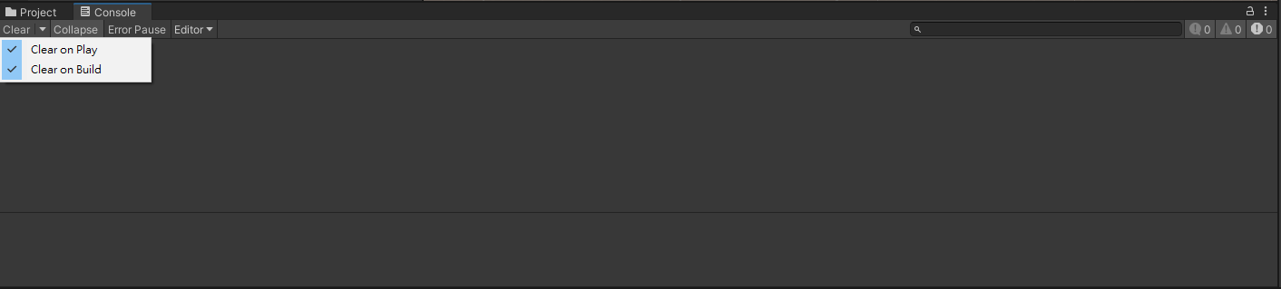
Introduction
Console
Basic message
Detailed message

Slide 45
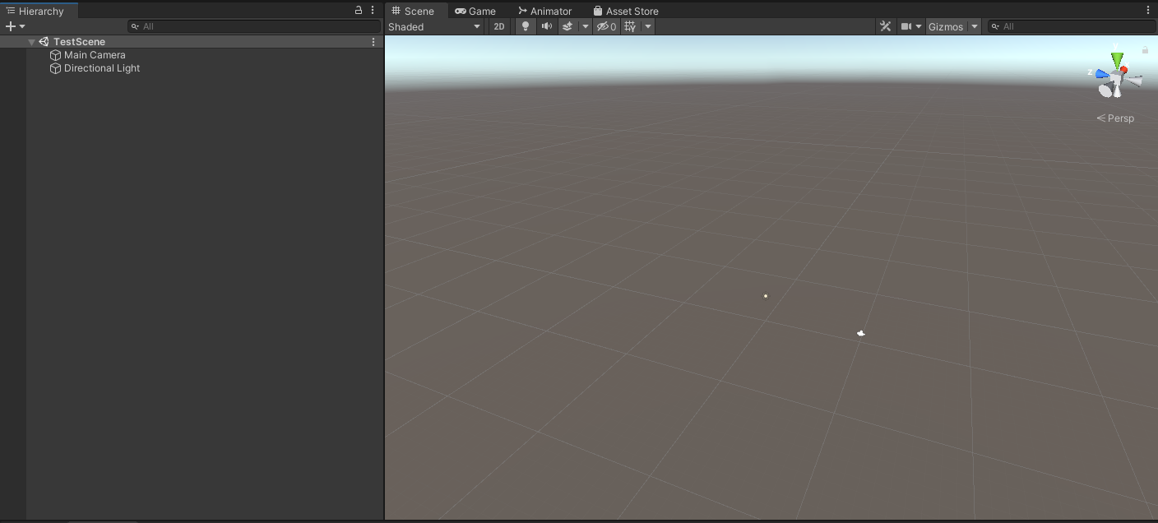
Introduction
Hierarchy & Scene

Slide 46
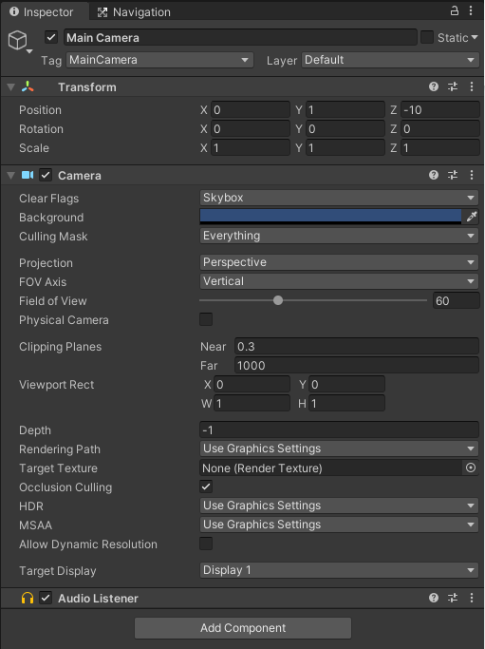
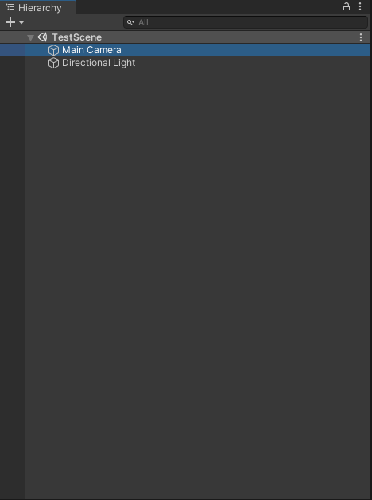
Introduction
Components(Normal Mode)
Component 1
Enable or not
Component 2

Slide 47
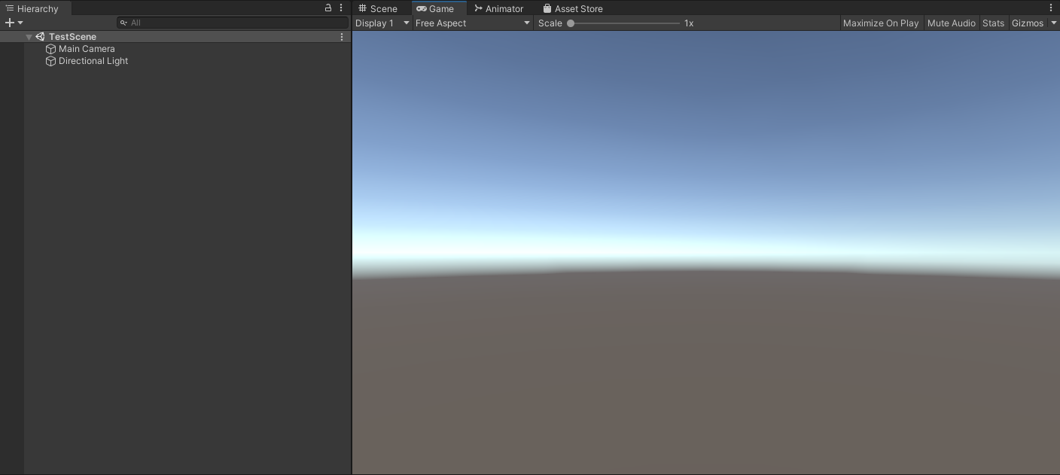
Introduction
Game

Slide 48

Introduction
Layout

Slide 49

Introduction
Add cube

Slide 50

Introduction
Add cube

Slide 51
Outline
Component Behavior

Slide 52

Component Behavior
New Script Component
2. Choose “C# Script”
3. Name “VikingController”
1. Right click

Slide 53

Component Behavior
New Script Component
Drag

Slide 54


Component Behavior
New Component
1. Select target game object
2. Choose the component you want

Slide 55

Component Behavior
New Script Component
Double click to edit it
Double click to edit it

Slide 56

Component Behavior
Work!

Slide 57
Component Behavior
MonoBehaviour
Turn a script into a component

Slide 58

Component Behavior
MonoBehaviour
Awake
Start
Update

Slide 59
Component Behavior
MonoBehaviour
Awake
Run even the component is not enabled
Start
After Awake(), once script component is enabled, before the first Update()
Only called once in the lifetime
Update
Called once per frame (usually need to use Time.deltaTime)
EX：Receiving Input, update object transform, simple timers

Slide 60


Component Behavior
MonoBehaviour
Awake
Start
Update

Slide 61
Practices
Show some messages when Awake, Start and Update are triggered

Slide 62
Component Behavior
Execution for event functions
For more details, please reference this
Script enabled
OnDestroy
End of cycle
Awake
Start
Script destroyed
Program start
Program logic
Update
Per frame

Slide 63


Component Behavior
GetComponent
Notes:
多型 polymorphism

Slide 64

Component Behavior
GetComponent
Change its position to (1, 1, 1) when starting

Slide 65


Component Behavior
Special components
Transform and gameobject can be accessed without using “GetComponent”
Usually we use “transform” rather than “gameObject”

Slide 66


Component Behavior
Add a public and private member in the script component
Notes:
在 play mode 調整數值並記錄，最後停止並調整

Slide 67

Component Behavior
Add a public and private member in the script component

Slide 68


Component Behavior
Add a public and private member in the script component

Slide 69

Component Behavior
Key event

Slide 70
Practices
Make your character(like cube) move by key event !

Slide 71

Introduction
Components (Debug Mode)
Notes:
把 instruction debug mode 帶到這裡說

Slide 72


Component Behavior
localPosition V.S. position
Local V.S. global
localPosition !
Notes:
Getkey() & getkeydown()
用 if 跟 if else if 的差別

Slide 73
Outline
Component-oriented Design

Slide 74

Component-oriented Design
Bad design
Player
Controller ICanDoEverything
Enemy
AI ICanDoEverything

Slide 75
Component-oriented Design
Bad design
Enemy
Collider DamegeDealer DamageAccepter | MovingSpeed AttackingSpeed ReactionTime | HP MP STR INT DEX | Transform MeshRenderer TrailRenderer ParticleSystem Animation | Weapon Shield Armor Loot

Slide 76
Component-oriented Design
Good design
Controller
Status
Characteristic
Etc

Slide 77
Outline
Using Package

Slide 78



Using Package
Import a package

Slide 79

Using Package
Import a package
Because this package was produced in an older version of unity

Slide 80

Using Package
Use some objects in the package
Drag
Preview

Slide 81


Using Package
Use some objects in the package
Drag

Slide 82

Using Package
Use some objects in the package
Drag
Preview

Slide 83

Using Package
Use some objects in the package

Slide 84

Using Package
Put those grounds under the landscapes

Slide 85
Practices
Use those Viking models in the package to your scene !

Slide 86
Outline
Building

Slide 87


Building
Build setting

Slide 88

Building
Build setting
Scenes you want to build
Current platform
Building Platform
Some settings

Slide 89

Building
Build setting
2. Check the scenes you want to build
1. Add the scene you open now
3. Switch the platform you want to build
4. Checked for convenience
5. Build !

Slide 90

Building
Build setting
Version number or date…

Slide 91

Building
Output
Double click to play !

Slide 92
Building
Build setting
※ some platforms like Android are not installed by default !

Slide 93
Building
Build setting
※ you can download other platforms by Unity hub
Choose those platforms you need

Slide 94
Practices
Output your product !

Slide 95
Building
FPS (frame per second)
Different platforms have different computing power and different FPS
It’s why we need to use Time.deltaTime in Update()

Slide 96
Outline
Tutorial Link

Slide 97

Tutorial Link
Official tutorial
https://unity.com/learn

Slide 98

Tutorial Link
Base Building Game
https://www.youtube.com/user/quill18creates?noapp=1&app=desktop

Slide 99
Outline
Notice

Slide 100

Notice
Don’t download the wild Unity !

Slide 101
Notice
When cooperation……
The same version of Unity
It is allowed to have several Unity with different version in your computer at the same time

Slide 102
Notice
When cooperation……
The “scene” file is very sensitive
Scene file was a binary file before
Scene file is yaml file now !
Don’t modify the code written by others without their permission
Ensure that the project you upload is executable!

Slide 103

Notice
Version control for unity (.gitignore)
Library
Temp
Builds
All Visual studio / Mono Develop generated items
For more details, please reference this or google Unity version control

Slide 104
Notice
Not only your codes but also all of your
Documents
Art works

Slide 105
Outline
Homework

Slide 106

Homework
Viking game
A Viking player walking by the keys “w, a, s, d”
Some grounds
Third-person perspective (the view always be the upper rear of the player)

Slide 107
Outline
Next Class

Slide 108



Next Class
White ??
Blue ??
Notes:
政治有分顏色難道 unity 也有嘛 !?!?

Slide 109

Outline
Thank you for your listening!

